Slide 1
Welcome

Slide 2
Yashwantrao school of rural developement
Department of Computer Science

Slide 3
Domain Specific Mini Project :-
Fitness Gym Website
-S.Y. MCA Mini Project

Slide 4
Project by-
Sr. No. | Students Name | PRN No.
1. | Pranali Vikram Patil | 2023071232
Under The Guidance of
-Dr. Nilam Khamkar

Slide 5
Contents
Sr. No. | Topic
1 | Abstract
2 | Introduction
3 | Problem Statement
4 | Architecture Diagram
5 | Snapshots
6 | Software & Hardware Requirement
7 | Conclusion

Slide 6
Abstract :-
The purpose of Gym Website is to automate the existing manual system by the help of computerized equipments and full-fledged computer website.
Customers can easily contact with us.
Our Gym management Software provides lots of functions such fees, plan, and physical fitness which help to provide good quality of services to customer from Gym managers.

Slide 7
Introduction :-
Our project is a website portal, that help users to join our fitness gym.
Users can select membership package according to their need and Sign up and log in the website.
Customer can check his updates online anytime about fitness or diet plan etc.
The focus of this project is about online services for a fitness club but by minimizing all those defects which are found in currently available manually file system.

Slide 8
Problem Statement :-
To Replace the cluttered design, poor navigation, and outdated content of the existing gym websites.

Slide 9
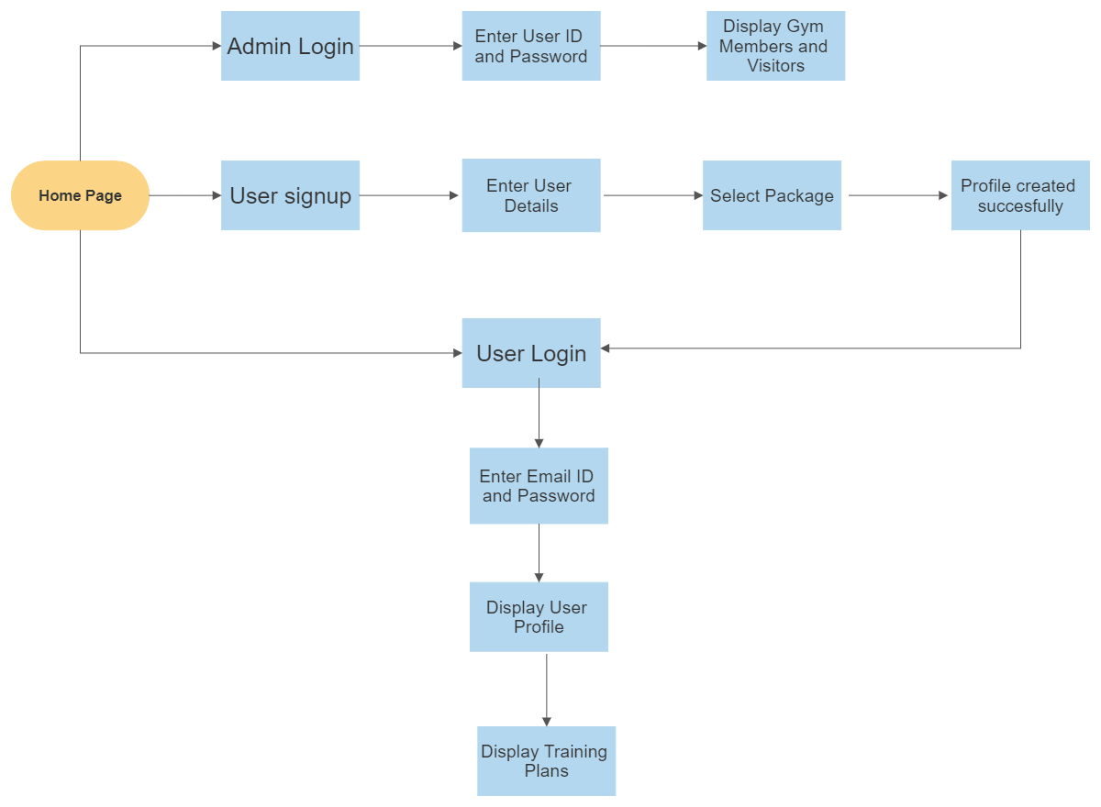
Architecture Diagram

Slide 10
Snapshots

Slide 11

Home Page

Slide 12
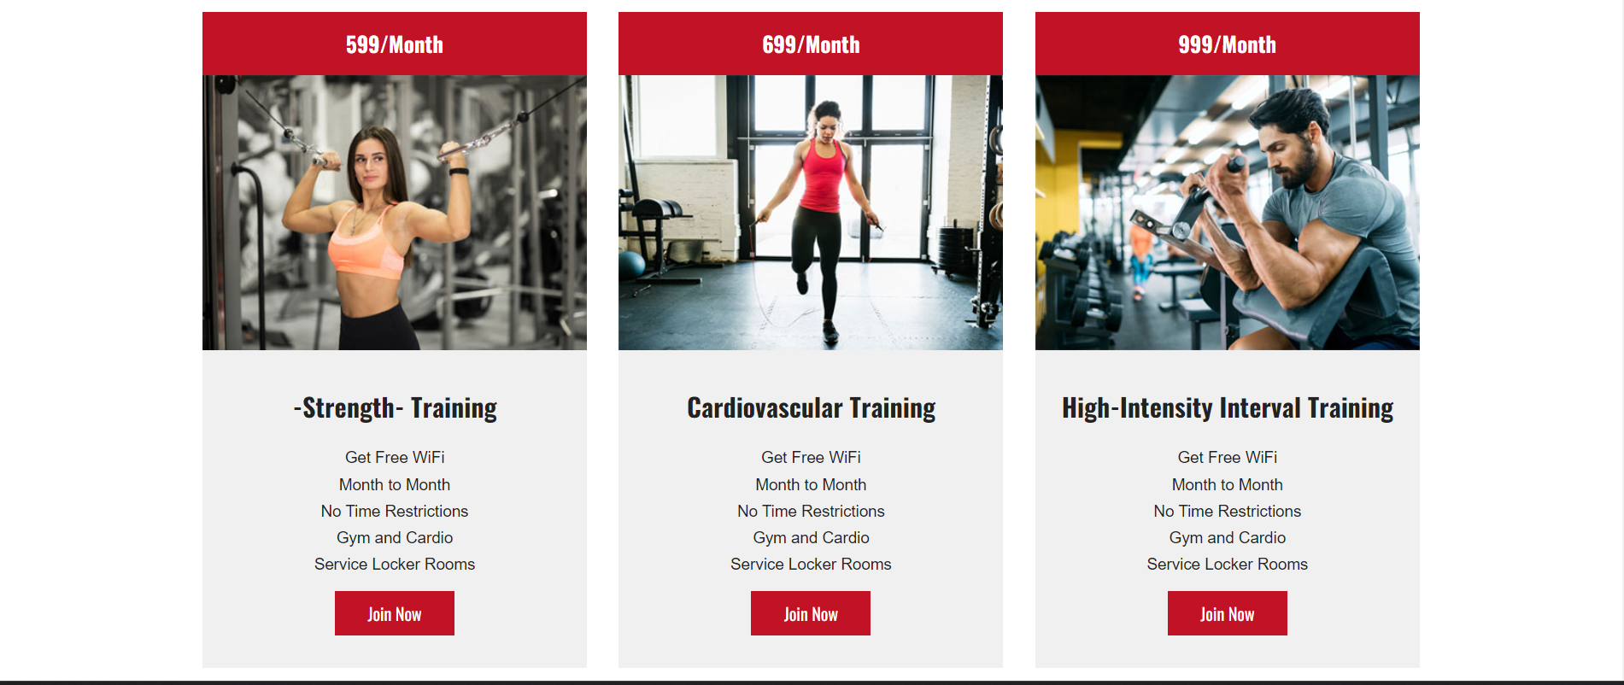
Choose Package

Slide 13
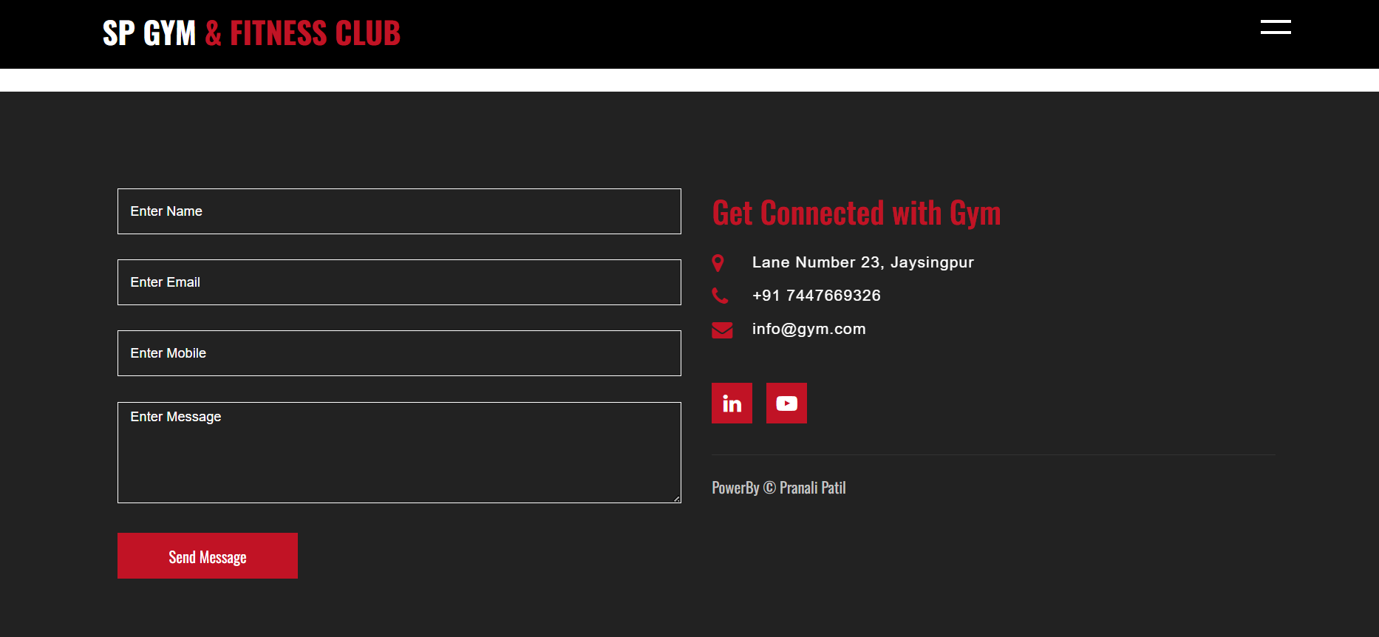
Client Information Page

Slide 14
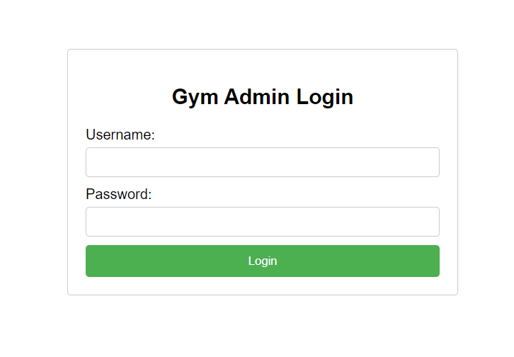
Admin Login Page

Slide 15
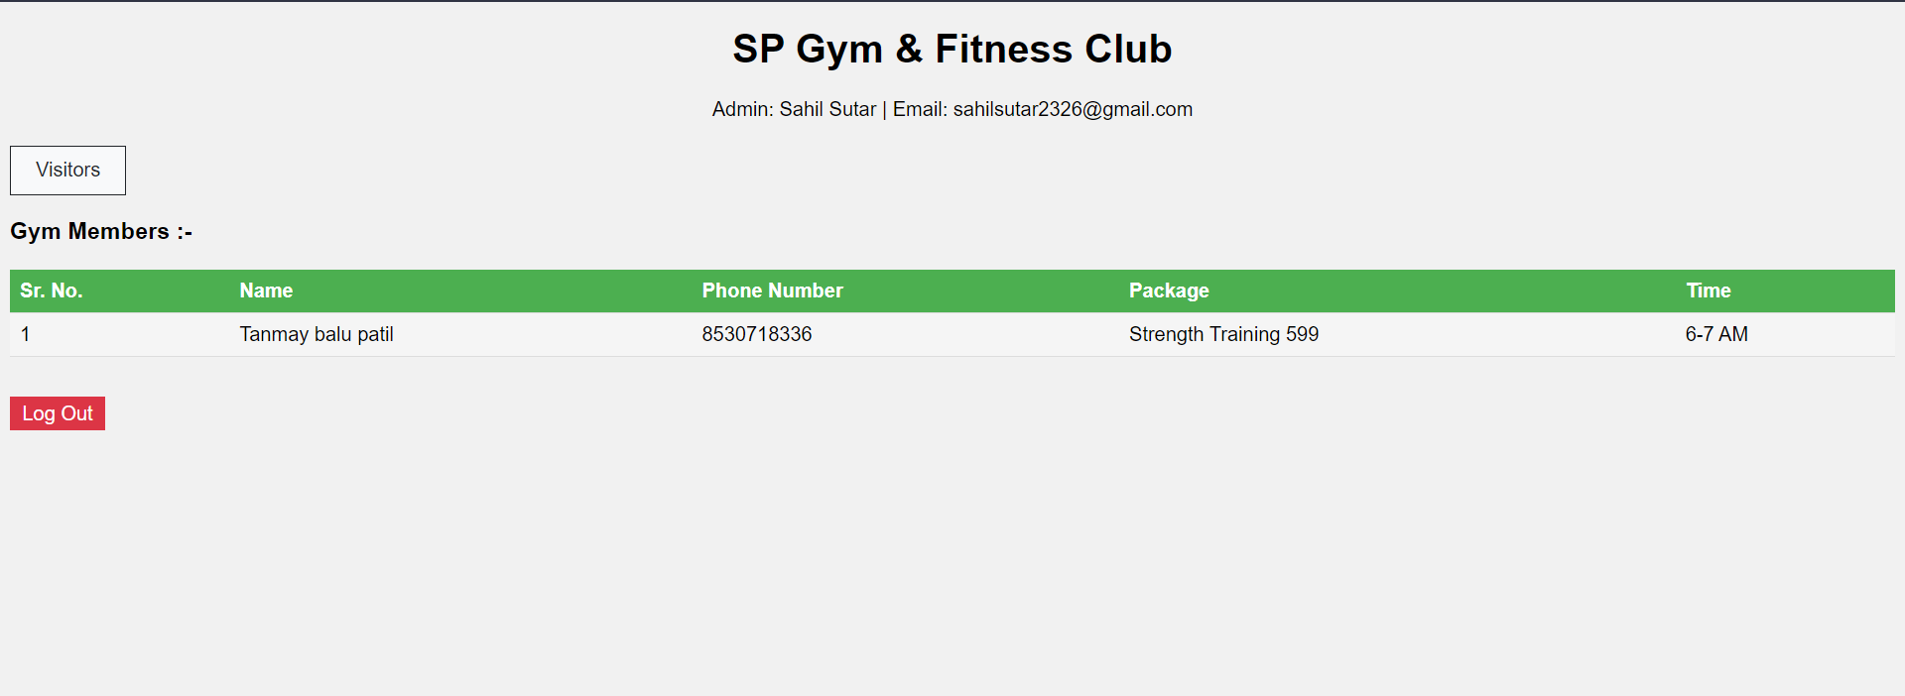
Admin Home Page

Slide 16
Software requirement: -
Operating system: Windows Operating System
Text editors: Visual Studio Code (Version 1.77.3)
Frontend Tools: HTML, CSS, JavaScript
Server: XAMPP(Apache)
Database : MySQL
Hardware requirements: -
Minimum 4 GB RAM
Minimum 100 GB HDD/SSD

Slide 17
Conclusion :-
Fitness website allows the user to join the fitness gym .This software package allows storing the details of all the data related to gymnasium . The implementation of the system will reduce the time as well as data entry

Slide 18
Thank You

